Slide 1
IoT-Based Sports Analytics

Slide 2
IoT-Based Sports Analytics: Enhancing Sports Performance through Data and Machine Learning
This presentation discusses the integration of IoT devices and Machine Learning in sports performance analysis, outlining the benefits, challenges, and future trends. It starts with an introduction to IoT-Based Sports Analytics, its importance, and its real-life applications. It then explains IoT in Sports, its benefits, and the role of Machine Learning in Sports Analytics.

Slide 3
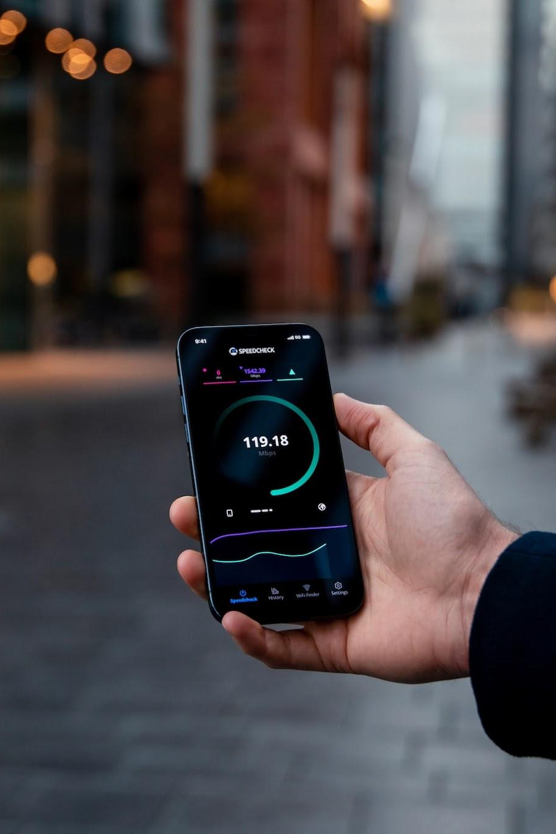
Introduction
IoT refers to a network of interconnected physical devices that collect and exchange data.
In the sports industry, IoT revolutionizes how we monitor and enhance performance.
From wearable devices tracking athletes' movements to smart equipment, IoT is redefining sports analytics.
Machine Learning processes this data to extract valuable insights, enabling coaches, players, and analysts to make data-driven decisions.

Slide 4
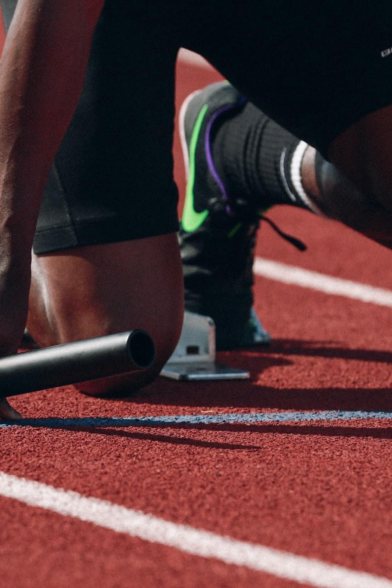
Importance of Sports Performance Analysis
Analyzing sports performance data holds immense significance for athletes and teams, as it empowers them to make data-driven decisions and ultimately enhances their performance. Here's why it's crucial:
Precision and Personalization
Injury Prevention
Tactical Insights
Performance Optimization
Real-time Adjustments

Slide 5
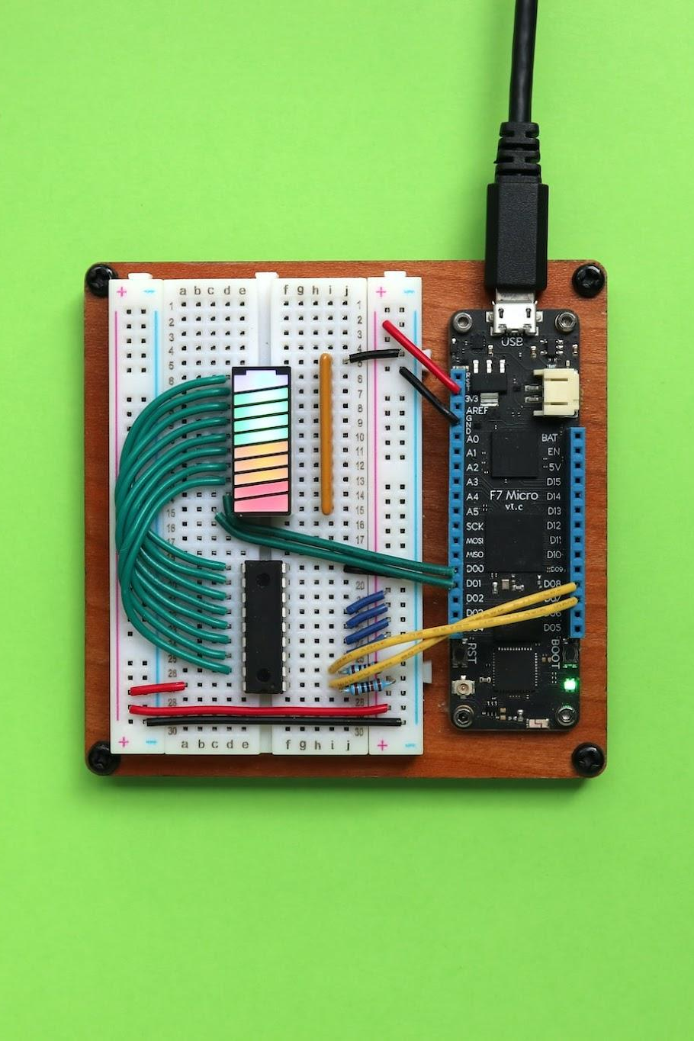
What is IoT in Sports?
Smart Wearables:
Wearable devices with sensors.
Collect data on movement, speed, and heart rate.
Sensors:
Attachable devices for tracking impact, acceleration, and body orientation.
Used on equipment and players.

Slide 6

Role of Machine Learning in Sports Analytics
Predictive Analysis:
ML algorithms analyze historical data to predict game outcomes.
Factors like player performance, strategies, and even weather conditions are considered.
Coaches and teams make informed decisions based on these predictions.
Pattern Recognition:
ML identifies patterns in player behavior and team dynamics.
Helps in understanding player strengths and weaknesses.
Enhances game strategies and individual training plans.

Slide 7
Challenges in IoT-Based Sports Analytics
Data Overload:
The multitude of IoT devices generates massive amounts of data.
Managing and processing this data efficiently is a significant challenge.
Data Accuracy:
IoT sensors and devices may occasionally provide inaccurate data.
Ensuring data quality and reliability is essential for meaningful analysis.
Privacy and Security:
Athlete biometrics and performance data are sensitive.
Protecting this information from breaches and misuse is a major concern.
Cost and Accessibility:
Implementing IoT systems can be expensive, limiting access for smaller teams.
Accessibility to advanced technology is a challenge for some sports organizations.

Slide 8
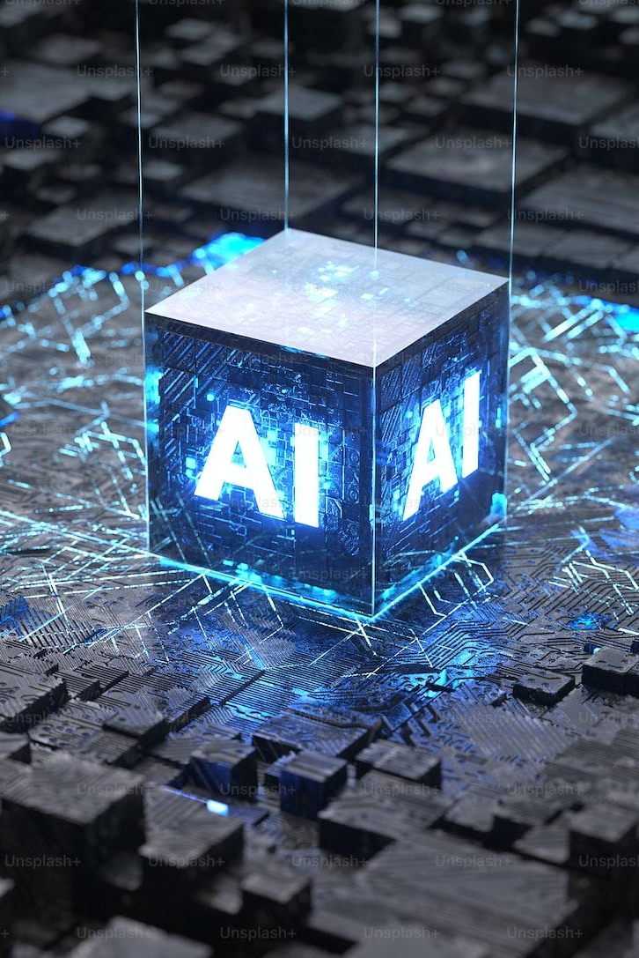
Future Trends
Real-time Insights:
Advancements in IoT technology will enable even faster real-time data collection and analysis.
Coaches and athletes will have access to immediate insights during games and training sessions.
Advanced Wearables:
Wearable devices will become more sophisticated, offering a wider range of biometric data, such as hydration levels and muscle fatigue.
This will lead to even more comprehensive performance analysis.
AI and Predictive Analytics:
AI and machine learning will play a more significant role in predicting game outcomes and player performance.

Slide 9
Conclusion
In the world of sports, technology is propelling us to new heights. IoT and Machine Learning have reshaped how athletes and teams approach performance analysis. The combination of real-time data from IoT devices and the analytical power of ML provides unparalleled insights. We've explored the challenges and future trends in this field, emphasizing the potential for more accurate predictions, personalized training, and enhanced fan engagement.

Slide 10
Thank you. Please feel free to ask any questions. 😄

